Slide 2
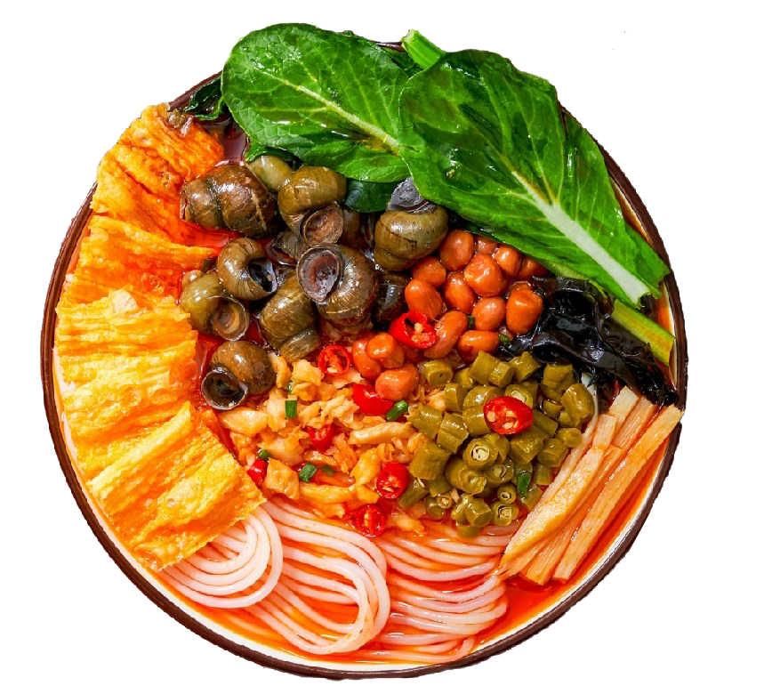
Designed by OfficePLUS
数据来源：艾媒咨询
52.78%
31.6%
每月都吃
每周都吃
4.85%
每半年都吃
消费者食用频率
5.03%
每年都吃
螺蛳粉
3.05%
从来不吃

